Slide 1
Law & Ethics, Policies &
Guidelines, and Security Awareness
1

Slide 2
Introduction
• You need to understand an organization’s legal,
ethical responsibilities
• To minimize liabilities and reduce risks, the
information security practitioner must:
– Understand current legal environment
– Stay current with laws and regulations
– Watch for emerging issues
2

Slide 3
Terminology (1)
• Cultural mores: fixed morals or customs of a group of people, form basis of ethics
Ethics: Rules that define socially acceptable behavior, not necessarily criminal, not enforced (via authority/courts)
Laws: Rules that mandate or prohibit behavior, enforced by governing authority (courts)
– Laws carry sanctions of governing authority, ethics do not
• Policy: “Organizational laws”
– Expectations that define acceptable workplace behavior
– General and broad, not aimed at specific technologies or
procedures
– To be enforceable, policy must be distributed, readily available,
easily understood, and acknowledged by employees
3

Slide 4
Terminology (2)
Standards, guidelines, best practices: define what must be done to comply with policy, how to do so
Jurisdiction: a court’s right to hear a case if a wrong was committed in its territory or against its citizens
Long-arm jurisdiction: court’s ability to “reach far” and apply law (another state, country)
Case law: documentation about application of law in various cases
Liability: legal obligation beyond what’s required by law, increased if you fail to take due care
Due care: has been taken when employees know what is/isn’t acceptable, what the consequences are
Due diligence: sustained efforts to protect others
4
Notes:
Liability

Slide 5
Types of Law
• Civil: laws governing nation or state
• Criminal: harmful actions to society, prosecuted by the
state
• Tort: individual lawsuits as recourse for “wrongs”,
prosecuted by individual attorneys
• Private: includes family, commercial, labor law
• Public: includes criminal, administrative, constitutional
law
5
Notes:
Civil laws
Criminal laws
Law of Tort

Slide 6
Law and Information Security
In practice, you can be sued for almost anything; no “absolute” protection against litigation
• Information security practices can:
– Reduce likelihood that incidents result in lawsuits
– Reduce likelihood that you lose (by showing due care, due diligence)
– Minimize damages/awards
– Help you respond effectively to incidents
We’ll focus on criminal laws.
6
Notes:
litigation

Slide 7
Relevant Federal Laws (General)
• Computer Fraud and Abuse Act of 1986 (CFAA)
• National Information Infrastructure Protection Act of 1996
• USA PATRIOT Act of 2001 (made permanent in 2006)
– Broadens reach of law enforcement agencies
– Broadens “protected” information regarding open records law
– Increased accountability, sanctions against money laundering
– National Security Letters: administrative subpoenas with permanent
gag orders
• Telecommunications Deregulation and Competition Act of 1996
• Communications Decency Act of 1996 (CDA) (partly struck down)
Computer Security Act of 1987: sets minimal federal government
security standards
7

Slide 8
Relevant Federal Laws (Privacy)
Federal Privacy Act of 1974: Federal government Electronic Communications Privacy Act of 1986: Regulates interception of electronic communications
Health Insurance Portability and Accountability Act of 1996
(HIPAA), Gramm-Leach-Bliley Act of 1999 (GLBA):
Requires privacy policies in healthcare and financial industries, restricts sharing & use of customer info
Family Education Rights and Privacy Act (FERPA):
Restricts distribution of “student academic records” (including
names and grades)
Freedom of Information Act of 1966: can request info from
gov’t, some info is protected
FACTA Red Flag regulation of 2009 (ID theft)
8

Slide 9
Relevant Federal Laws
(Copyright)
•
Intellectual property (IP) protection
countries
Copyright law extends to electronic
in U.S., other
•
•
formats
With citations, you can include brief portions of others’
work as reference (“fair use”)
Nigeria Copyright Office website:
https://www.eregistration.copyright.gov.ng/
Digital Millennium Copyright Act of 1998 (DMCA):
criminalizes circumvention of technological copyright
protection measures (some exceptions)
9
•
•

Slide 10
State and Local Regulations
• Restrictions on organizational computer technology
use at state, local levels
• Information security professional responsible for
understanding applicable regulations, compliance
• State regulations:
– state notify data breach victims
– Open records, anti-spam laws
10

Slide 11
International Laws and Legal Bodies
• European Council Cyber-Crime Convention:
– International task force oversees Internet security
functions for standardized international technology laws
– Attempts to improve effectiveness of international
investigations into breaches of technology law
• General Data Protection Regulation (GDPR):
requires website disclosure about data collection,
user consent (Europe)
11

Slide 12
United Nations Charter
• Makes provisions, to a degree, for information
security during information warfare (IW)
• IW uses information technology to conduct
organized and lawful military operations
• IW is fairly new type of warfare, although
military has been conducting electronic
warfare operations for decades
12
Notes:
information warfare (IW)

Slide 13
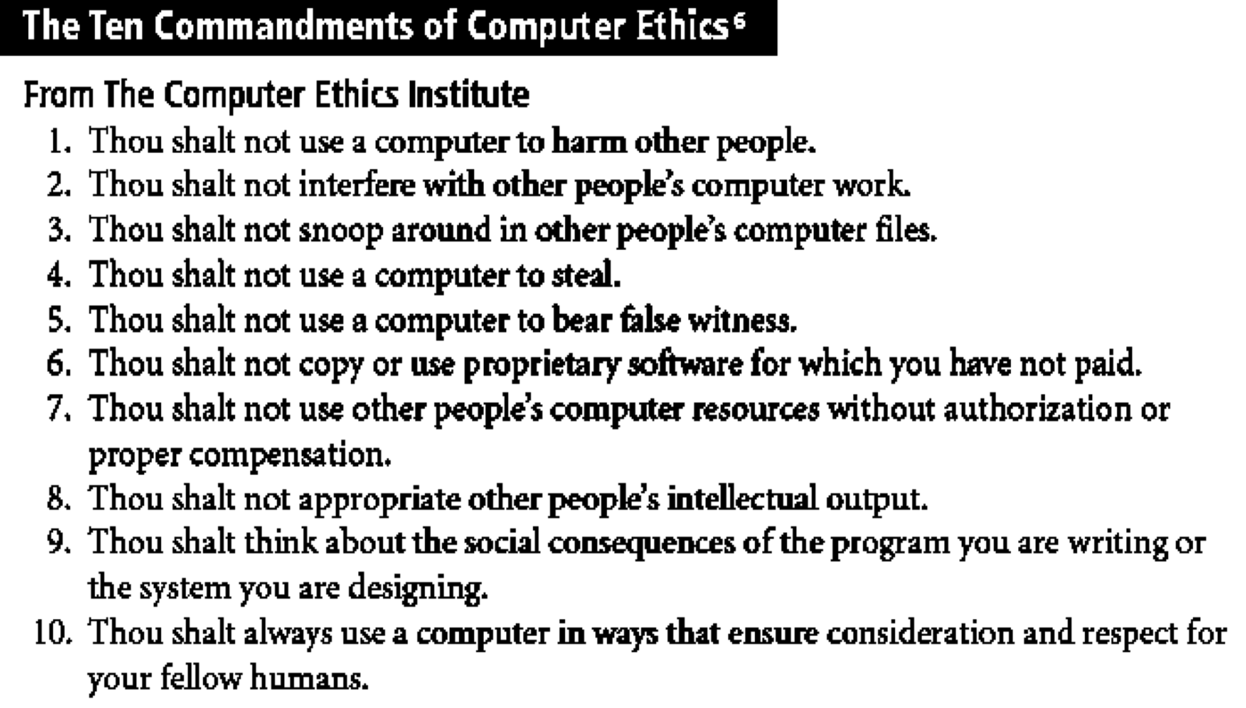
Ethics
and
Information
Security
13
Notes:
Very important

Slide 14
Ethical Differences Across Cultures
• Cultural differences create difficulty in
determining ethical behavior
• Difficulties arise when one nationality’s
ethical behavior conflicts with ethics of
another national group
• Example: many ways in which Asian cultures
use computer technology considered piracy
14

Slide 15
Ethics and Education
• Education levels ethical perceptions within a
small group of people
• Employees must be trained in expected
behaviors, especially regarding information
security
• Proper ethical training vital to creating
informed, well prepared, and low-risk system
user
15

Slide 16
Association of Computing
Machinery (ACM)
• ACM established in 1947
educational and scientific
as “world’s first
computing society”
• Code of ethics contains references to
protecting information confidentiality,
causing no harm, protecting others’ privacy,
and respecting others’ intellectual property
16

Slide 17
Computer Security Institute (CSI)
• Provides training to support computer,
networking, and info. security professionals
• Argued for adoption of ethical behavior among
info.
security
professionals
17

Slide 18
Policy, Standards and Practices
• Communities of interest need to consider
policies as starting point for security efforts
• Policies direct how issues should be addressed
and technologies
used
• Security policies
execute but most
are least
difficult
expensive controls to
to implement
• Shaping policy is difficult
19

Slide 19
OSU Policies
• Policies
and Standards
•
Standards
–
Responsible Use of
University Computing
Network Resources
Archives & Retention
–
University Computer
Security Standards:
• Min. Computer Security
• Critical Server Security
• Web Server Security
• DB Server Security
Local Administrative
Privilege Standard
&
–
–
Merchant Services & Use
of Credit Cards
Deployment, Use of
Wireless Data Networks
Public Records
Data Policy
Personal Info Disclosure
–
–
–
–
–
•
See http://ocio.osu.edu
for more details
20

Slide 20
Policy Management
• Policies management needed due to change
• To remain viable, security policies must have:
– People responsible for reviews
– A schedule of reviews
– Method for recommending reviews
– Specific policy issuance and revision date
21

Slide 21
Information Classification
• Information classification an important aspect of policy
(e.g., public, internal, classified)
• Specific company policies may be classified, but
general guidelines shared among companies
• A clean desk policy stipulates that at end of business
day, classified information
• Questions:
– Feasibilities?
– Benefits?
is
properly
secured
22

Slide 22
Security Education, Training, and
Awareness Program
Security education, training and awareness
(SETA) implementation should follow
security policy
– Designed to reduce accidental security breaches
– Training builds on general knowledge employees
need for their jobs (focused on security aspects)
23

Slide 23
Security Education
Everyone in an organization needs to be trained and aware of information security; not every member needs formal degree or certificate in information security
When formal education for individuals in security is needed, an employee can identify curriculum available from local institutions of higher learning or continuing education.
A number of universities have formal coursework in information security.
24

Slide 24
Security Training
• Involves providing members of organization
with detailed information and hands-on
instruction designed to prepare them to
perform their duties securely
• Management of information security can
develop customized in-house training or
outsource the training program
25

Slide 25
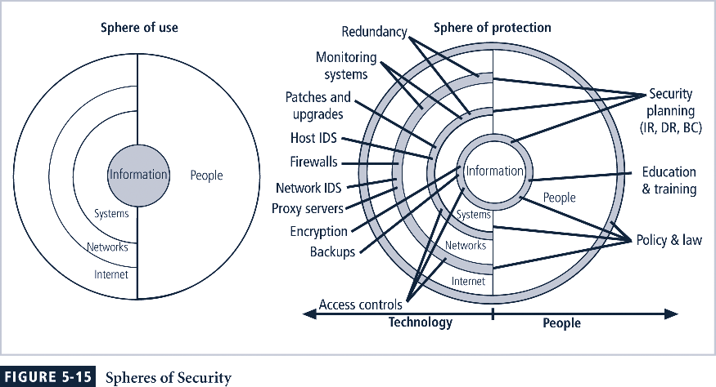
Spheres
of
Security
26

Slide 26
Design of Security Architecture
• Defense in depth
– Implementation of security in layers
– Requires that organization establish sufficient
security controls and safeguards so that an intruder
faces multiple layers of controls
• Security perimeter
– Point at which an organization’s security
protection ends and outside world begins
– Does not apply to internal attacks from employee
threats or on-site physical threats
27

Slide 27
Security Technology Components
Firewall: device that selectively allows information into/out of organization
• Demilitarized Zone (DMZ): “no-man’s land”
between inside, outside networks; some
companies place Web servers here
• Intrusion Detection Systems (IDSs): detects
unauthorized (strange) activity on organizational
network, individual machines, or both
28

Slide 28
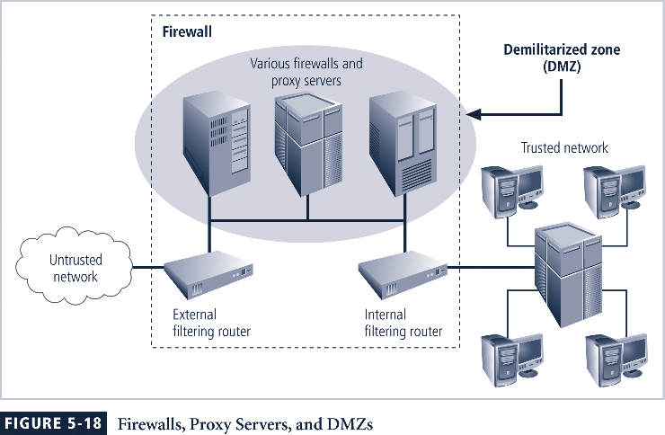
Network
Security
Architecture
29

Slide 29
Summary
Laws: state-enforced rules that mandate or
prohibit certain behavior; drawn from ethics
• Ethics: define socially acceptable behaviors
(may vary among groups)
• Policies: organizational laws
• Management needs to “set tone” for security
practices, support their deployment
30

Slide 30
References
Class note by Adam C. Champion, Ph.D.

